Slide 1
Prepared for the
19th Annual American Indian Tourism Conference
September 12-14, 2017
Oneida, Wisconsin
Introduction to Tribal Cultural and Intellectual Property Rights
Prepared by
Melody L. McCoy, Staff Attorney
Native American Rights Fund
Boulder, Colorado
www.narf.org

Slide 2


Cultural Property = tangibles
Intellectual Property = intangibles
NAGPRA

Slide 3
Cultural Property Protected by Federal Law
Sites
Remains
Animals & Plants

Slide 4
Federal Cultural Sites Laws
HSA
NHPA
ARPA
NAGPRA

Slide 5
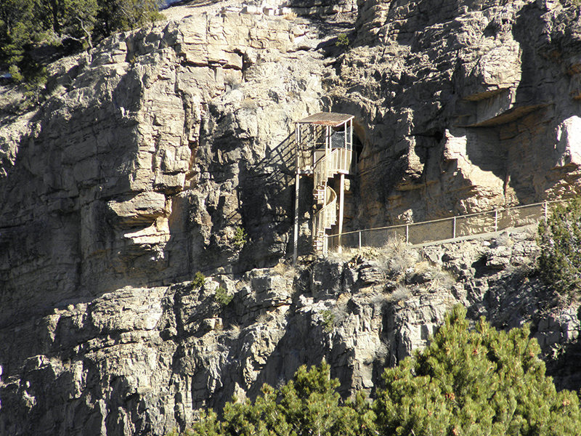
Pueblo of Sandia v. United States (1995)
National Historic Preservation Act

Slide 6
Federal Cultural Remains Laws
ARPA
NMAIA
NAGPRA

Slide 7
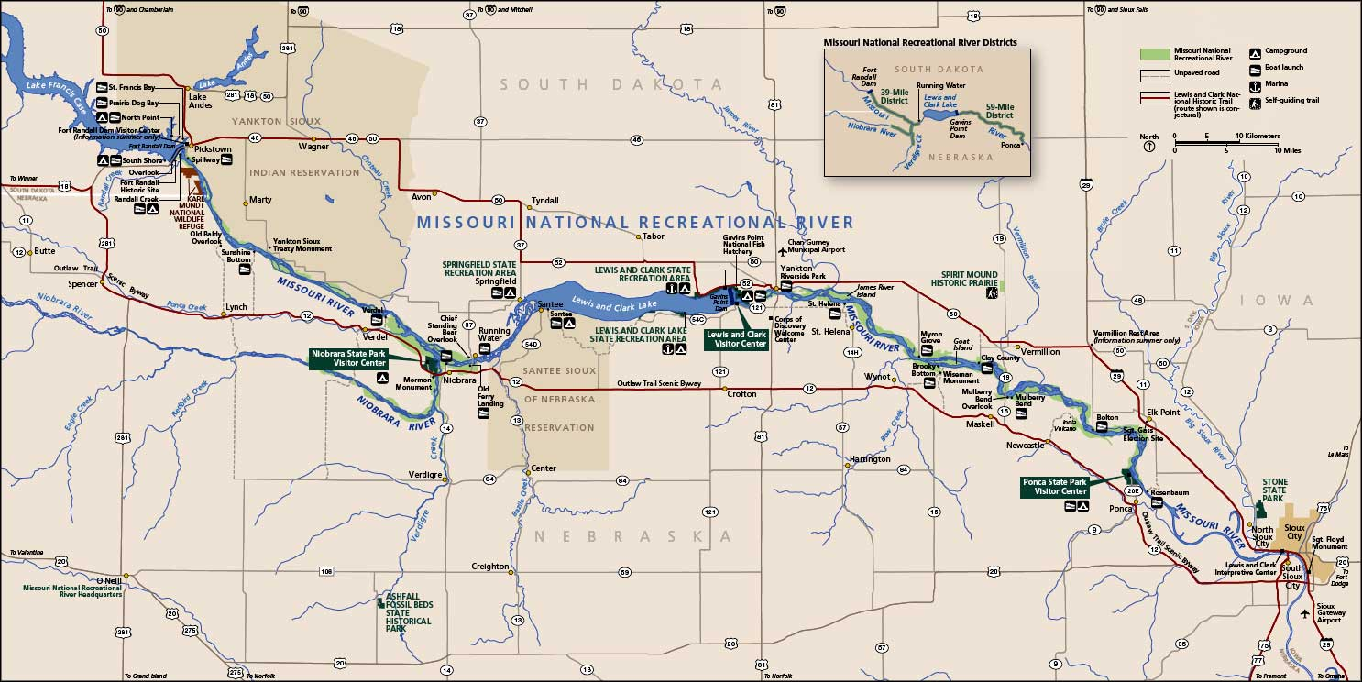
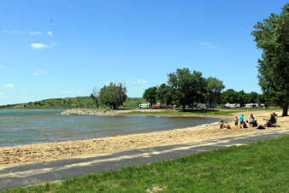
Yankton Sioux Tribe v. U.S. Army Corps of Engineers (2007)
Native American Graves Protection and Repatriation Act

Slide 8

Federal Animals and Plants Protection Laws
ESA
Lacey Act
  Tribal Law

Slide 9
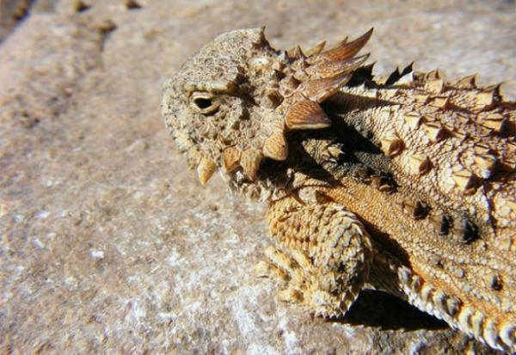
Quechan Tribe v. U.S. Dep’t of the Interior (2010)
Endangered Species Act

Slide 10
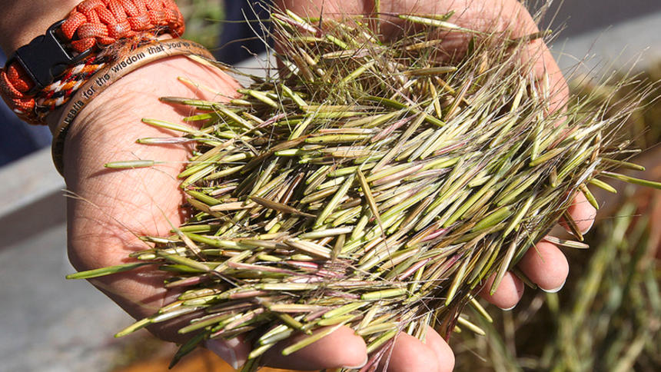
Minnesota Chippewa Indians (2015)
Lacey Act

Slide 11

Tribal Cultural Property Codes
Regulate Cultural Resources
Stop damage & misappropriation
Plan for economic development

Slide 12
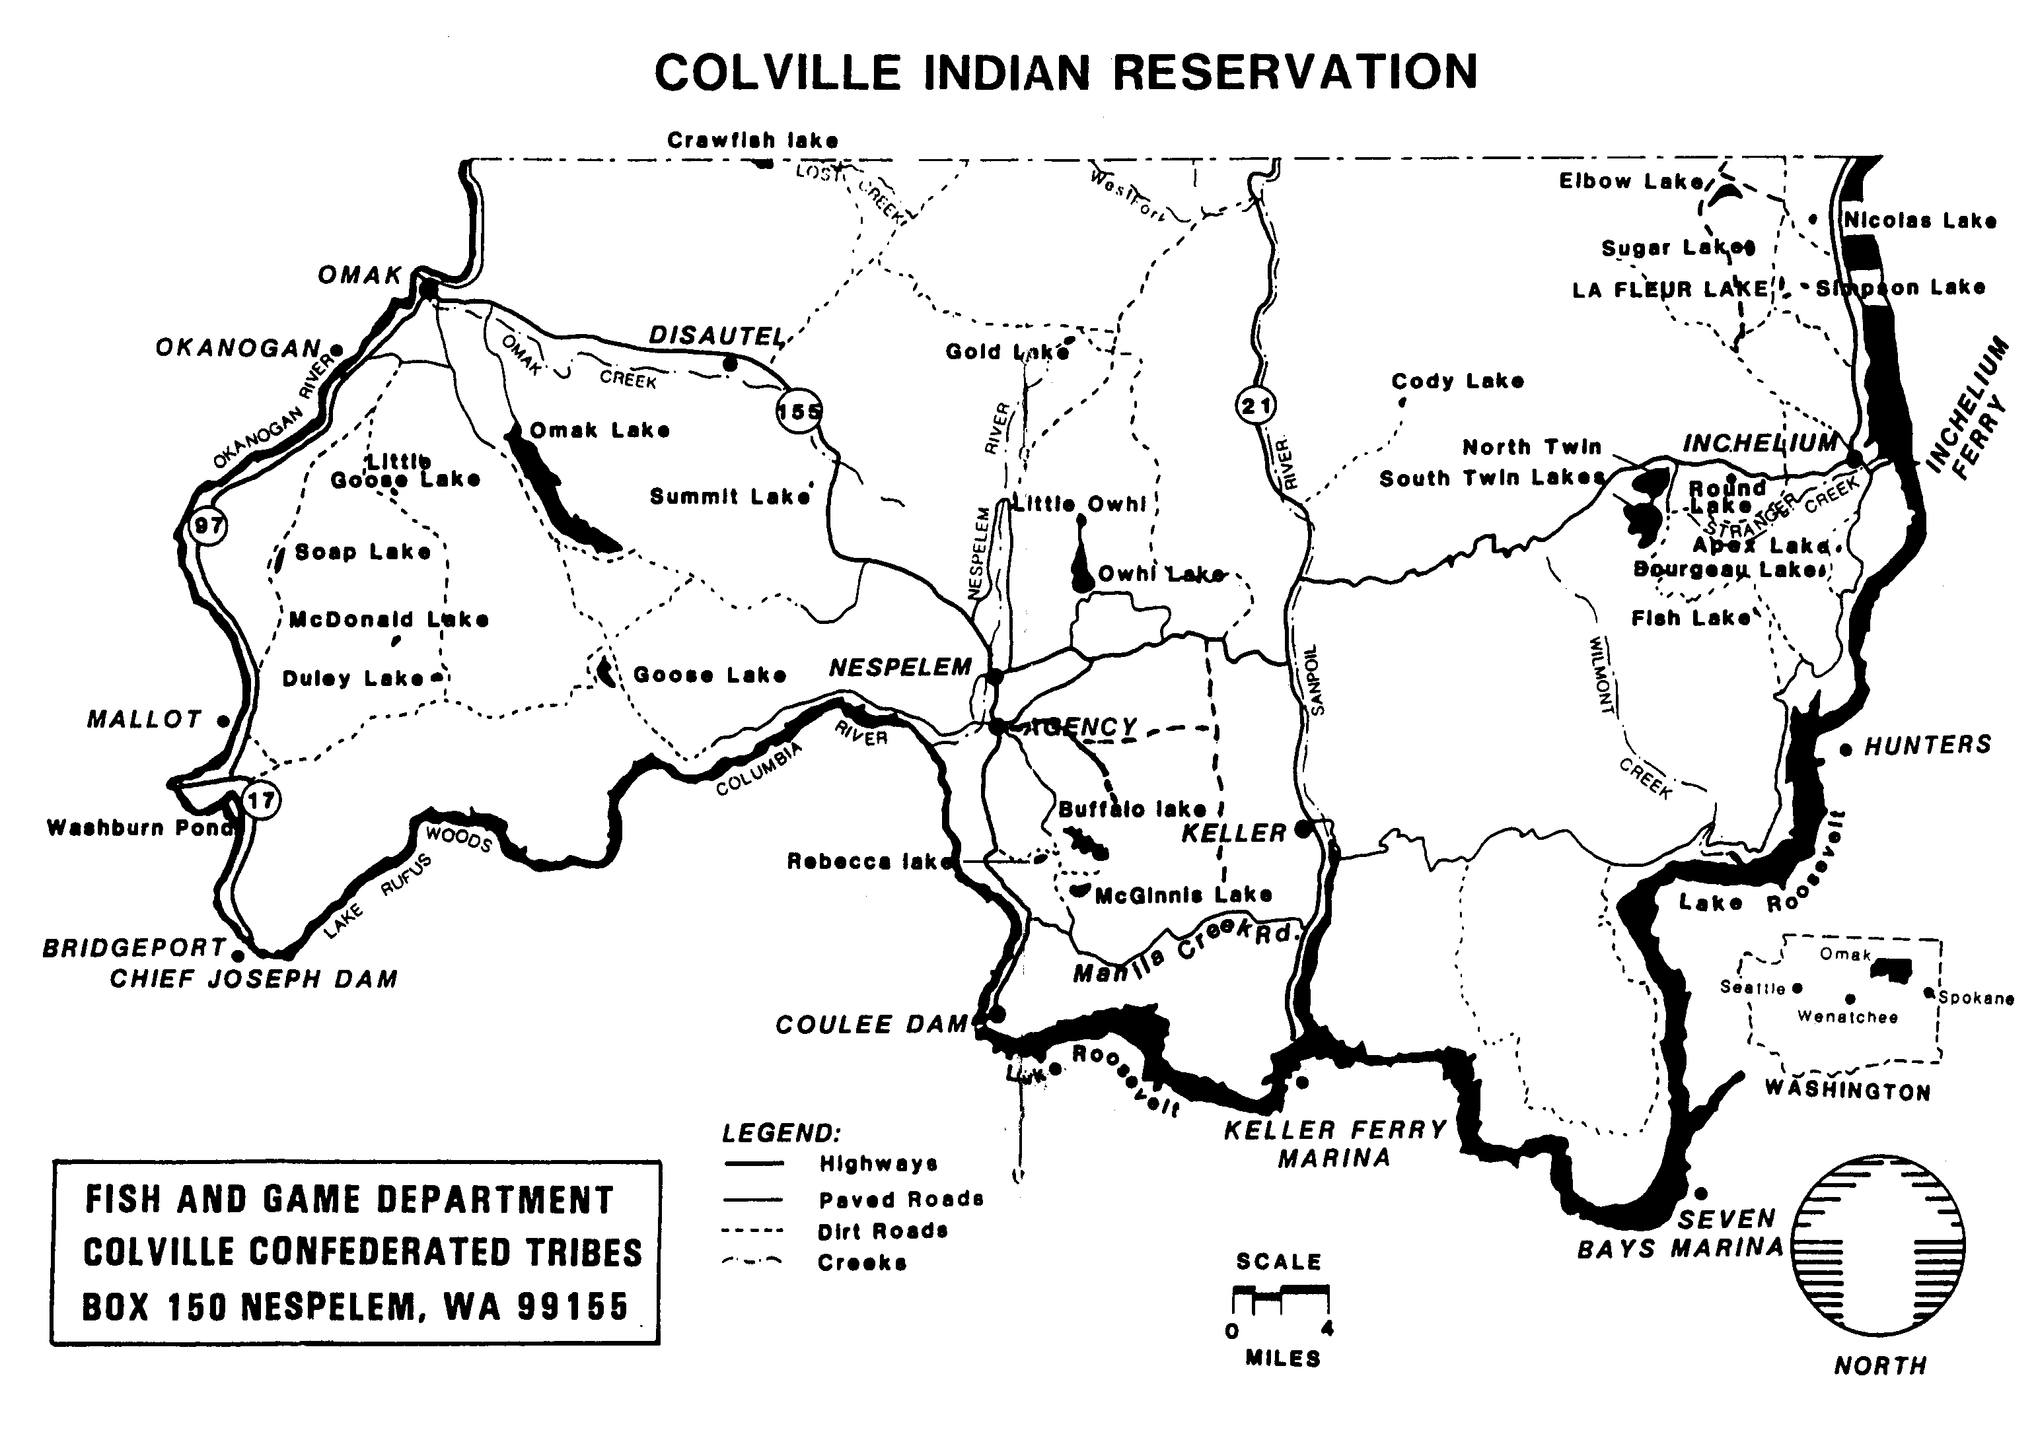

Hoover v. Colville Confederated Tribes (2002)
Deer, elk, plants

Slide 13
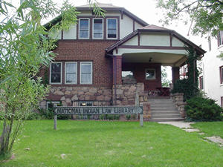
Tribal Codes Collection
http://www.narf.org/nill/triballaw/index.html

Slide 14
Federal Intellectual Property Laws
Copyright ©
Patent
Trademark™

Slide 15



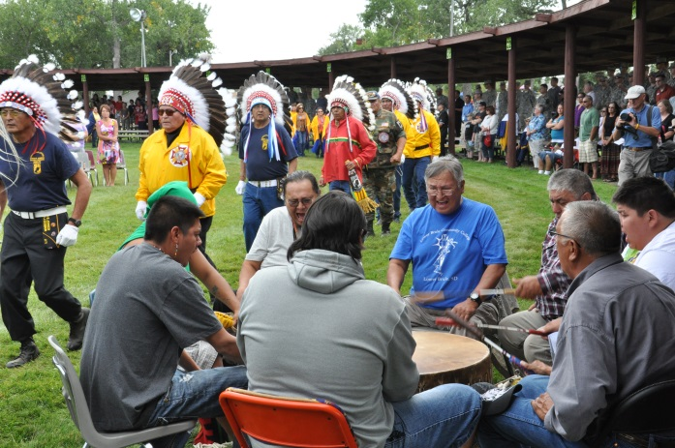
Copyright
Authorship?
Limited duration?

Slide 16
Copyright Case
Tuolumne Band of Me-Wuk Indians v. Baca,
No. Civ.-F-03-6363, (E.D. Cal. Feb. 17, 2005)
Dance video
Music CD
Injunction

Slide 17




Patents
Product or Process
Novel?

Slide 18

Patent Applications
    Blackjack play method (2015)
      National telephone lottery system (2011)

Slide 19
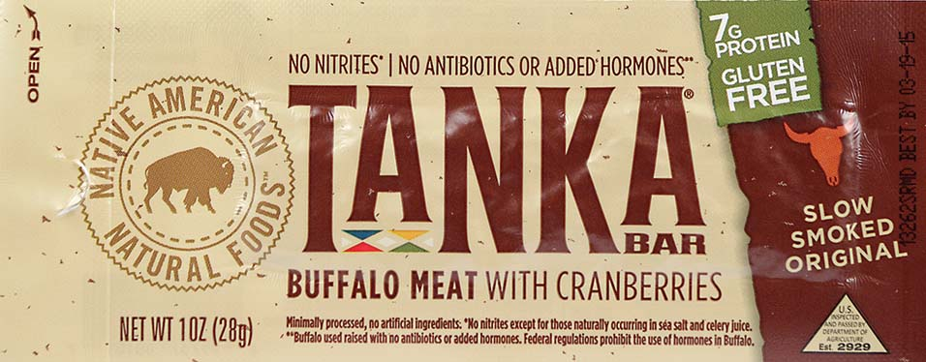



Trademark Law
Symbols
Commercial?

Slide 20

Trademark Case
Lumbee Tribe v. Anheuser-Bush (2016)

Slide 21

Indian Arts and Crafts Act
1935 + Amendments
Trademark & Truth
in marketing provisions
Criminal penalties

Slide 22
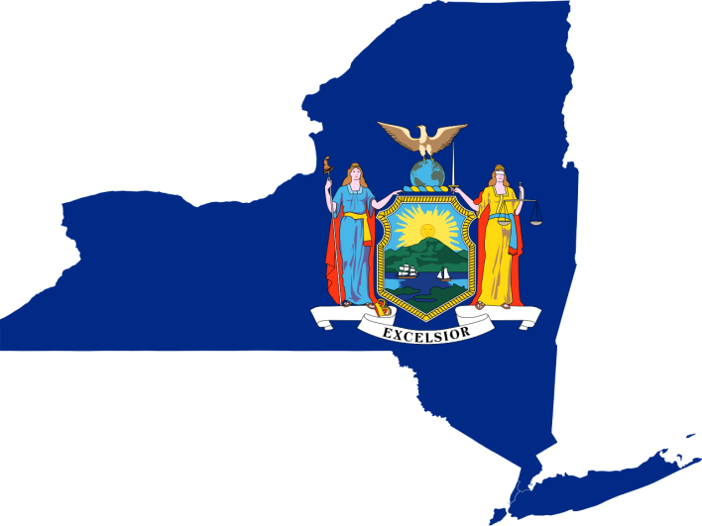
Indian Arts and Crafts Act
Criminal cases

Slide 23
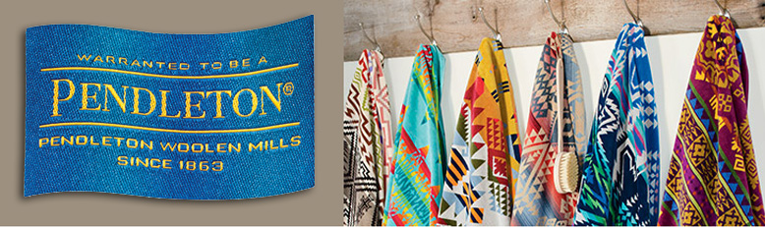
Indian Arts and Crafts Act
Settlements
http://nativenewsonline.net/currents/indian-arts-crafts-act-settlement-pendleton-woolen-mills-reached/

Slide 24
Indian Arts and Crafts Act
Litigation
Native American Arts, Inc.
-- Over 150 court cases in 15 years
    Navajo Nation v. Urban Outfitters
    -- Filed February 2012, federal district court, New Mexico
    -- Claims under Lanham Act & IACA

Slide 25
Indian Arts and Crafts Act
Navajo Nation v. Urban Outfitters
UO using name / mark “Navajo” since 2001
To sell clothing, jewelry, footwear, house wares
Navajo Hipster underwear & flasks online sales in 2011

Slide 26
Indian Arts and Crafts Act
Navajo Nation v. Urban Outfitters
Tribe argues consumer confusion and deception under IACA
Dec. 2015, Court allows these claims to go forward
May 2016, Court approves Tribe’s damages calculation
($1,000 /product / day vs. $1,000 / day)

Slide 27

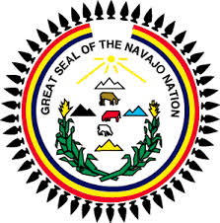

Indian Arts and Crafts Act
Navajo Nation v. Urban Outfitters
September 2016, Settlement!!

Slide 28
International Law
United Nations Declaration on the Rights of Indigenous Peoples (2007)
  Article 11
  States’ redress may include restitution for intellectual property taken
  Article 31
  Right to maintain, control, protect and develop intellectual property

Slide 29

Tribal Copyright & Patent Codes
Pre-emption
states
tribes
Infrastructure & resources
Enforcement

Slide 30
Tribal Trademark / Arts & Crafts Codes
States
Model State Trademark Bill
14 States Indian Arts & Crafts Sales Laws
Tribes
Cherokee, Navajo, Yurok
Practical & economic costs

Slide 31

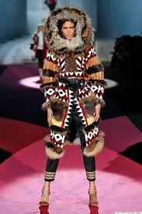



Non-Law Protection Efforts
Social Media
  DSquared2
  Paul Frank

