Slide 1
International Outreach Working with Tour Operators
September 12, 2017
Presented by Mary Motsenbocker & Catherine Prather

Slide 2
Working with Tour Operators

Slide 3
Today we’ll cover:
What is NTA and who are our members?
The NEW landscape of tour operator packaged travel
Tips for working with tour operators
Feedback from NTA operators for AIANTA attendees
Catering to international visitors & receptive operators
AIANTA’s Mission: To define, introduce, grow and sustain American Indian, Alaska Native and Native Hawaiian tourism that honors traditions and values.

Slide 4
What is ?
Professional community where you …
make business connections,
learn from your peers,
make a difference through advocacy
access news and research
Only association that registers tour operators to serve the inbound group leisure market from China
AIANTA partner!

Slide 5
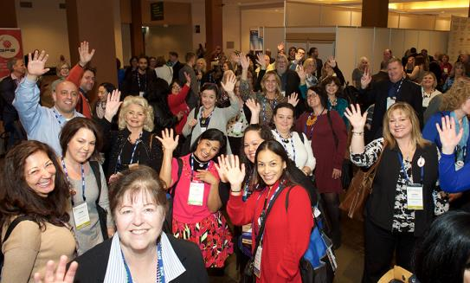
…And who are our members?
Tour operators
Tour suppliers
DMOs
Travel agents
Associates

Slide 6
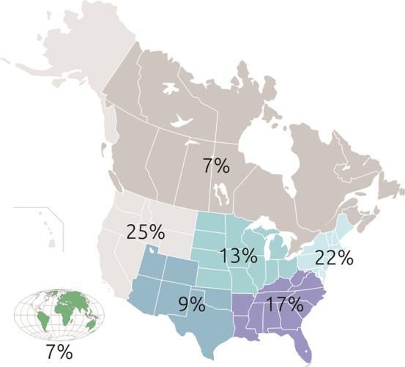
Members by location

Slide 7
Age of clients

Slide 8
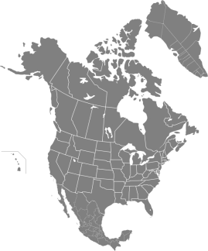
Business Model
Receptive services 62%
Inbound travel to North America 35%

Slide 9
Business Model

Slide 10
Top markets, packages offered
National Parks 74%
Family 60%
Historic/Heritage 67%
Culinary 52%
Events 64%
Faith-based 34%
Student 63%
Gaming 25%

Slide 11
The NEW Landscape of Tour Operator Packaged Travel

Slide 12
The NEW Landscape of Tour Operator Packaged Travel
Smaller groups
Changing demographics of travelers
Demand for experiences; special interest activities
FIT or independent travel
Choice, customization, freedom
Family groups
Individual experiences within group itineraries
Best of both worlds
Choice + customization + group camaraderie

Slide 13
The NEW Landscape of Tour Operator Packaged Travel
Demand for higher quality products/services/amenities
Savvy travelers know what they want; this includes “value”
Expectation of special treatment
Unique/special experiences
Authenticity & cultural immersion
Late booking
Not only want it all … but want it now!
Adapting to and incorporating technology
Instant gratification society
Expect same technology platforms with their travel experience

Slide 14
NEW Landscape = Opportunity for Suppliers/DMOs
Smaller groups & FIT
New markets
Review comp policies and group pricing
Higher quality services/amenities & unique/individual experiences
Showcase customer service
Audit product offerings; highlight USP
Late booking
Review deposit policies
Respond quickly to operator requests

Slide 15
Tips for Working with Tour Operators

Slide 16
How can suppliers become a part of an operator’s package?
“Give us something that the general public cannot do.”
“What I want is that unique experience or attraction that sets your destination apart.”
“We tour operators like to simplify, so if you add value to our package by putting tour parts together, it makes our life easier!”
“We sell full programs, not parts (like a car vs. spare parts). We would rather work with a supplier who can offer several things in an area than have to take all the parts and make them into a tour.”
“Give us slower dates when we can package 5-star properties at 3-star rates.”
“Offer consistent pricing. I do proposals up to two years out, and if I can't count on your pricing to be somewhat stable, I will quit checking with you.”
“E-blasts that cold-call hundreds of tour operators will more than likely get deleted.”

Slide 17
How can suppliers/DMOs increase the number of travelers on a tour?
“Send us high-quality images for Web and print.”
“Send us a ‘group-friendly’ video for email blasts or a DVD to show on the coach.”
“Group-friendly” means don’t show pricing
“Send us blurbs or write-ups that talk about what’s special at your place.”
“Cross-promote on social media.”
“Native people have always told stories.”

Slide 18
How much consideration do tour operators give to logistics?
“If we’ve got 50 seniors on a coach, we have to consider logistics.”
“Restrooms—and lots of them—are key.”
“Luggage handling is imperative for seniors, and it has to be done in a timely manner.”
“Hours of operation can be huge.”
“Please give a contact number for nights and weekends.”
“Please let us know where the bus drop-off and the group check-in areas are located.”

Slide 19
What do you need from attractions?
“We have a check list:
Adequate restroom facilities. If you don’t have them, you need to own up, and we’ll stop before we get there.
Someone to greet the group, especially if they understand group dynamics
Somewhere for the group to sit—a staging area
Docent to help us if we need help
Gift shop with things that include post cards and stamps
Something to eat
A special gate or group entry area”

Slide 20
Feedback from NTA Operators for AIANTA Attendees Peaks, Valleys and Guidance

Slide 21
Peaks
Relevant product and attractions for groups (of all sizes)
Solid marketing and marketing support
Appropriate (and cost effective) accommodations
Appealing dining facilities and food service
Senior friendly attractions and activities
Museums offering cultural (interactive) experiences

Slide 22
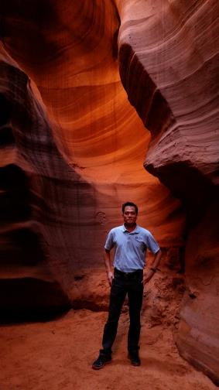
Valleys
Lack of lodging with reasonable rates and good proximity to sites
No planning for groups such as
motorcoach parking
group prices
places for seniors to sit and watch
food services for a group

Slide 23
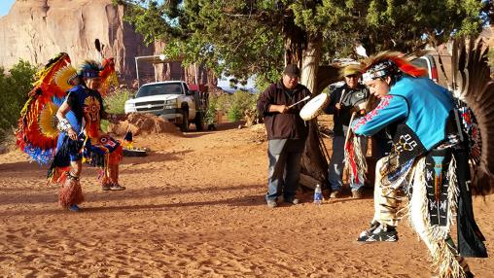
Guidance
Provide solid information on dates, possible services and prices in advance
Offer reasonable group rates
Step up the marketing to tour operators; build awareness
Show your interest: Have a designated packaged travel market representative

Slide 24
Guidance
Get involved with the industry and actually meet with tour operators
Educate operators on your special cultural offerings
Maintain dialogue with operators; ask for feedback and act on it
Take that knowledge to train others and build infrastructure that works
Represent—with authenticity—your culture
“Our stories are based on a reverence for the natural world— honoring the gift of life, our ancestors and all creatures. These stories root us to our past and guide us into our future.”

Slide 25
Catering to International Visitors & Receptive Operators

Slide 26
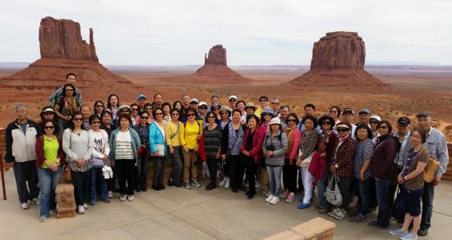
International Visitors
The general needs are the same—group friendly facilities, attractions, activities and experiences
More keen interest in native cultures from international visitors
Strong desire to interact with Native Americans
Want an authentic experience rather than one planned for tourists
Not afraid to try traditional foods

Slide 27
China Market Overview

Slide 28
Stats & Trends
135 million Chinese international travelers in 2016, spending $261 billion
In 2016, 2.97 million Chinese travelers visited the United States, spending $34.8 billion.
Chinese international travelers are less than 10% of the population. Less than 6% of Chinese citizens have passports.
2nd-tier cities emerging

Slide 29
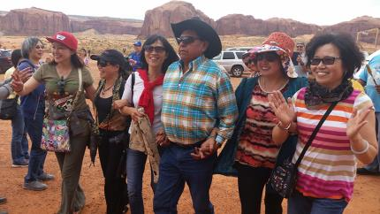
Who are Chinese international travelers?
Chinese growing middle class
Millennials: nearly half were born in 1970s and 1980s
56% are female
Family/Multi-generation

Slide 30
Chinese international traveler behaviors
Spending higher share of income on travel
Attractions, food and shopping are important
Less shopping, more spending on meaningful experiences
70% use mobile apps for booking; 90% for planning, sharing and reviews
Chinese collective culture (KOLs)

Slide 31
Thank you!

