Slide 1
AMERICAN INDIAN TOURISM CONFERENCE
SEPTEMBER 14, 2017

Slide 3
SYNOPSIS
A young Native American struggles to hold onto his identity in the face of a nation that attempts to strip him of his culture. Spurred on by the last words his father ever spoke to him, “Son, you’re an Indian, I want you to show other races what an Indian can do.” Jim Thorpe transcends every obstacle to become a beacon of hope for his people and “The World’s Greatest Athlete."

Slide 4
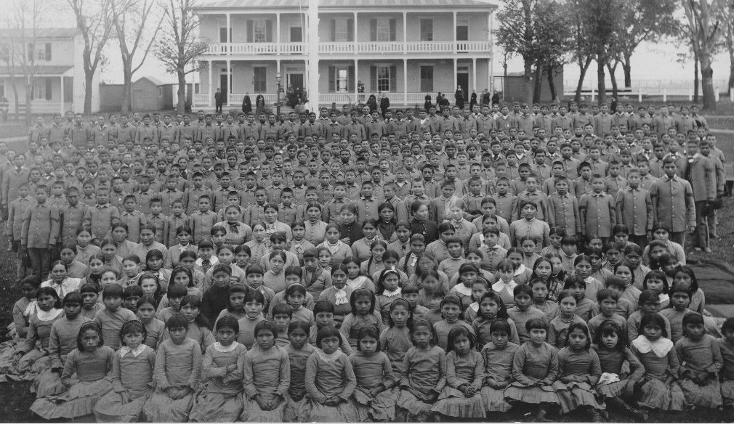
BACKGROUND
A bulk of the story takes place at the Carlisle Indian Industrial School (1879-1918). Carlisle was among the first Indian boarding schools and became the model for the off-reservation boarding schools that lasted until the mid 1990s. Carlisle had a 10% mortality rate. Over 1000 native children died due to poor living conditions, lack of nutrition, abuse (physical and mental), and home sickness.
10,595 Children from 144 Tribes

Slide 5
SIOUX | CHIPPEWA | SENECA | ONEIDA | CHEROKEE | MOHAWK | PUEBLO | APACHE | CHEYENNE
BLACKFEET | WINNEBAGO | OSAGE | MENOMINEE | OTTOWA | ONONDAGA | ALASKAN | NEZ PERCE | OMAHA
ARAPAHO | CREEK | TUSCARORA | SHOSHONE | CROW | PAWNEE | CHOCTAW | MISSION | SHAWNEE
PIMA | POTTAWATOMI | SAC AND FOX | KLAMATH | STOCKBRIDGE | PORTO RICAN | KIOWA | COMANCHE | ASSINIBOINE
PONCA | PENOBSCOT | NAVAJO | GROS VENTRE | WYANDOTTE | CADDO | CAYUGA | WICHITA | KICKAPOO
IROQUOIS | DELAWARE | ARIKARA | CHITIMACHA | COLVILLE | PAIUTE | DIGGER | FLATHEAD | HOPI
MIAMI | MODOC | BANNOCK | CHICKASAW | IOWA | PAPAGO | PUYALLUP | CLALLAM | UTE
WASHOE | QUAPAW | YUMA | CATAWBA | LUMMI | PEORIA | POKANOT | KAW | SEMINOLE
SPOKANE | TLINGIT | WALLA WALLA | WAMPANOAG | SHINNECOCK | UMATILLA | PASSAMAQUODY | CAYUSE | HOOPA
OKANAGAN | MANDAN | NOMELAKI | LITTLELAKE | POMO | SANPOIL | ABENAKI | HIAWATHA | NOOKSACK
PITT RIVER | SILETZ | COEUR D' ALENE | COOS BAY | OTOE | SKOKOMISH | UMPQUA | CHECTO | CHINOOK
KOOTENAI | MOJAVE | MUNSEE | NARRAGANSETT | SERRANO | SHEBITS | UKIAH | WISHOSHKAN | YAKIMA
CHEHALIS | GOPAH | MAKAH | OREGON | PAMUNKEY | TSIMPSHEAN | UINTAH | ALGONQUIN | ALLEGHENY
CHELAN | COAHULLA | CONCOW | COQUELL | COVELO | COWLITZ | CREE | DALLES | EHNEK
FILIPINO | KALISPELL | KEECHI | KLICKITA | LAPWAI | LONGHORNE | MONO | OLAMPOLI | PENDOREILLE
 | SAMSEAU | SKAGIT | SQUAMISH | TEWAN | WYLACK | YUCKICREEK | HIDATSA

Slide 7
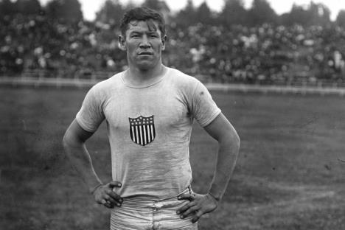
BACKGROUND
Jim overcame near insurmountable challenges to become the greatest all-around athlete in the history of modern sports. He won Olympic Gold Medals in the Pentathlon and Decathlon in the 1912 Swedish games. Professionally, he played baseball for the New York Giants and football for the Canton Bulldogs where he won three championships. In 1920, he became a founding member and the first president of the AFL, known today as the National Football League.

Slide 8
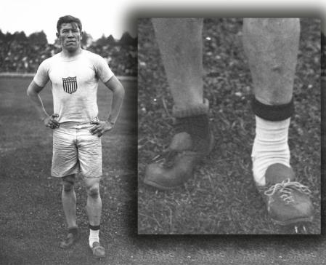
THORPE TRIVIA
Entering the final event of the Decathlon, Thorpe had such an impressive lead that he only needed to finish 7th or better in the 1,500 meter race to win Olympic Gold. After the runners were called to the track, Thorpe dug into his gym bag to find his shoes missing. Someone had stolen them.
Frantically, he searched for his shoes, to no avail. With the
race about to begin, he found two mismatched, badly-worn shoes: one, two-sizes too big, the other, a size too small. With socks doubled up on the one foot, Thorpe put a thin dress sock on the other and got to his mark just in time for the race to begin.
After trailing the pack for the first three laps, Thorpe caught the leaders rounding the final turn, and with a great burst of speed, he surged ahead and won the race by an astounding 25 yards. He captured the Gold Medal and was pronounced “The World’s Greatest Athlete” by King Gustav of Sweden.

Slide 9
We are proud to announce
MARTIN SENSMEIER as JIM THORPE

Slide 10
BEST KNOWN FOR
$162M WW
Box Office
WIND RIVER
Coming Aug 4
2017

Slide 11
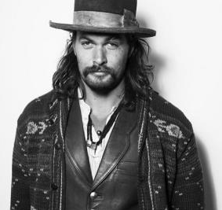
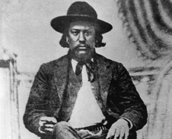
We are proud to announce
JASON MOMOA as HIRAM THORPE (JIM’S FATHER)

Slide 12
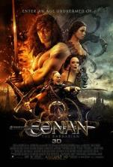
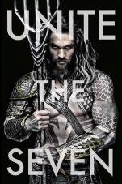
BEST KNOWN FOR
HBO Series
$49M WW
Box Office
Now on
NETFLIX
JUSTICE LEAGUE
Coming Nov 17
2017
AQUAMAN
Coming Dec 21
2018

Slide 14
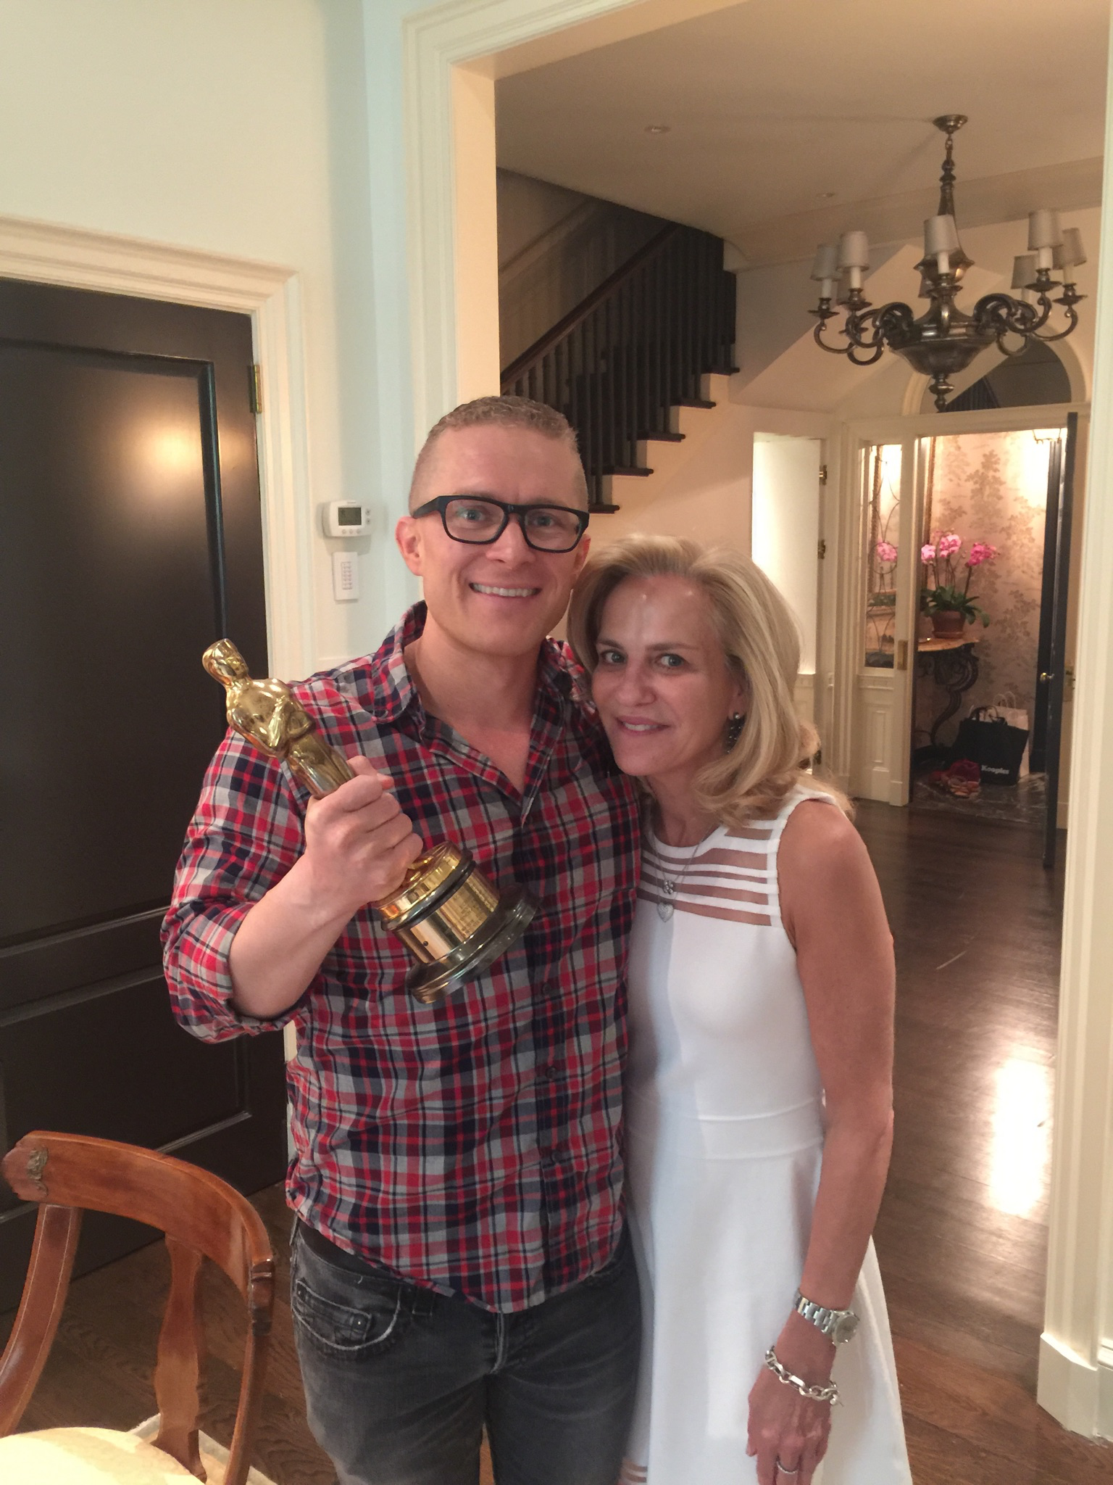
WENDY FINERMAN, Academy Award winning producer of FORREST GUMP and THE DEVIL WEARS PRADA, has joined the BRIGHT PATH team to bring this story to a global audience.
Wendy’s films have collectively grossed $1.5 billion in global box office.

Slide 15
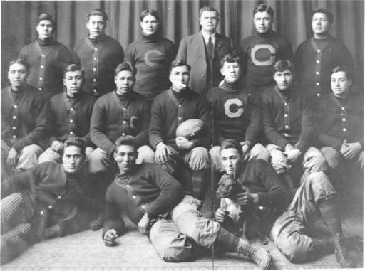
CASTING
“INDIAN COUNTRY”
FOR THE 1912 TEAM
Middle Row (left to right):
Henry Roberts (Pawnee)
Joe Bergie (Chippewa)
Bill Newashe (Sac & Fox)
Samson Bird (Blackfeet)
Jim Thorpe (Sac & Fox)
Joel Wheelock (Oneida)
William Garlow (Tuscarora)
Back Row (left to right):
Stancil Powell (Cherokee)
Hugh Wheelock (Oneida)
Lone Star Dietz (Chippewa)
Pop Warner
Peter Jordon (Chippewa)
Elmer Busch (Mission)
Front Row (left to right):
Alex Arcasa (Colville)
Eloy Sousa (Mission)
Gus Welch (Chippewa)

Slide 16
PARTNERSHIP AND FUNDING
We are close to finalizing funding for BRIGHT PATH and are seeking additional Tribal Partnerships. We ask that you join the Tuolumne Band of Me-Wuk Indians, The Mohegan Tribe, Tony Sanchez (Seminole FL), and the Yocha Dehe Wintun Nation in bringing this important story to the world.
YOCHA DEHE
WINTUN NATION
The Tuolumne Band of Me-Wuk Indians
Contact Executive Producers Rick Hill (920.265.1567) of the Oneida Tribe of Wisconsin or Chris Taylor (337.940.1799) of the Chitimacha Tribe for more information. HUYA!

Slide 17
PARTNERSHIP OPPORTUNITY
We are raising a minimum of an additional $750,000 in equity. Units are available at $500,000 per unit. We are offering an 18% priority return and a 2.5 % equity stake in the project for each unit. This will include a single card opening credit.
Partial units are available at $250,000 and $100,000.
The distribution expectation is a minimum 2,500 screen theatrical nationwide release.

Slide 18
LEGACY PROJECT
With the success of Birth of a Nation at the 2016 Sundance Film Festival, the 2017 Academy Award winning Best Picture Moonlight, and the runaway Box Office hit Hidden Figures, to name a few, Hollywood and global audiences are clamoring for diverse stories. “Diversity” is THE buzz-word in the industry.
BRIGHT PATH is uniquely situated to capitalize on this prevailing sentiment in a unique way, offering a story told from the perspective of Hollywood’s most under-represented voice. Told from the Native-perspective, BRIGHT PATH will give its audience a glimpse into the life and struggle of one of the world’s greatest achievers. “Jim Thorpe’s accomplishments will never be equaled. Period. But it is impossible to understand the greatness of his achievements without first understanding what he had to overcome to accomplish what he did. His is the ultimate story of triumph.” – Abraham Taylor, BRIGHT PATH Writer and Producer

Slide 19
HUYA! - SPECIAL THANKS
OUR ANCESTORS
BILL THORPE
TOULOMNE BAND OF ME-WUK INDIANS
THE MOHEGAN TRIBE
TONY AND PAULA SANCHEZ – SEMINOLE NATION
The YOCHA DEHE WINTUN NATION
The Tuolumne Band of Me-Wuk Indians

