Slide 1
September 2017

Slide 2
History of Project
2014: Destination Website Committee
2015: Website launched at AITC
2013: AIANTA/NTGISC Committee
Mission: Platform to supply accurate info representing U.S. tribal tourism destinations.
Dual Capacity Building Objectives:
Geospatial Information
Tourism Assessment & Development
Agency Luckie & Co. awarded contract to build site in October 2015
Anna Barrera contracted in November 2015 for Research & Content Development

Slide 3
Big Questions Asked in 2015
What types of attractions and accommodations should be listed on the website?
How will we collect this information?
Who is authorized to list a tribe or attraction on the site?
What information should partners provide to list on the site?
How do we protect AIANTA from risk?
What do we call this website? What are we trying to convey with the brand?
How will we integrate mapping tools that tribes can use for community planning?
How do we educate visitors about tribes?
How do we organize 567 federally-recognized tribes-worth of information?
How are we going to fund this website long-term?
How do we police for non-authentic listings?
How are we going to get the word out about the site?
How do we deal will border/land and tribal name differences?
How can the website be a tool for tribal tourism development?

Slide 4
Through the generous support of the BIA Dept. of Transportation…

Slide 5
AIANTA launched Indian Country’s first destination website

Slide 6
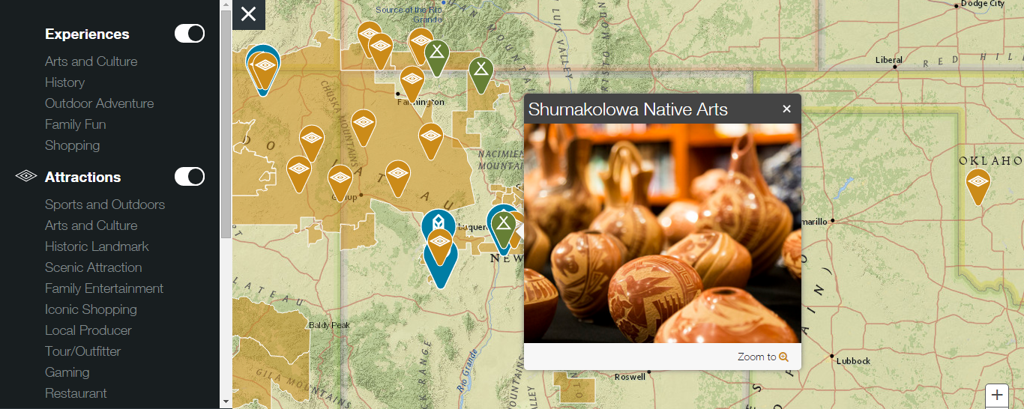
…featuring interactive maps of tribes and attractions

Slide 7
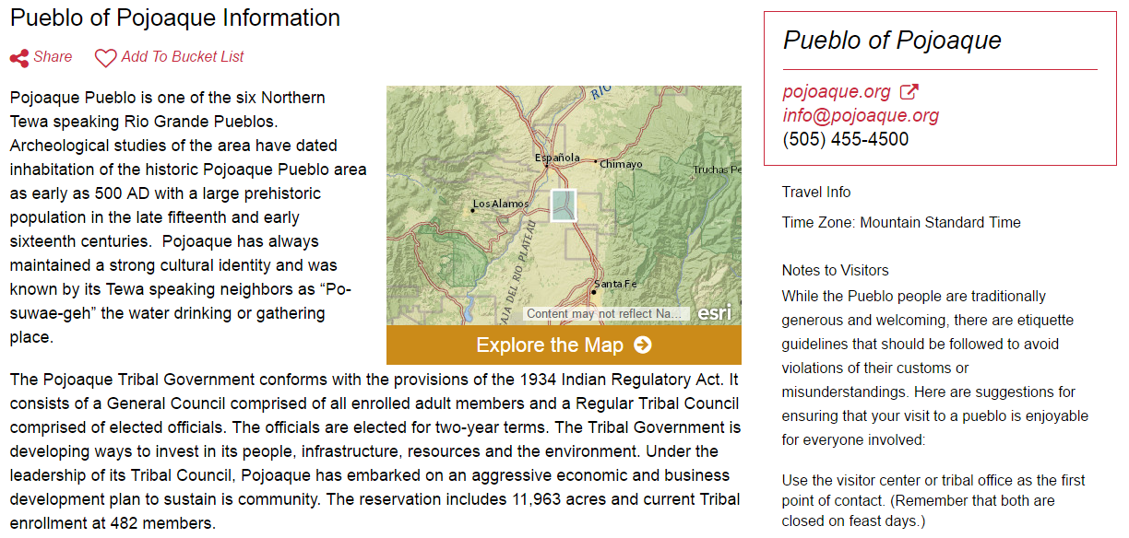
…and 567 pages for each tribe to tell their story.

Slide 8
The site features dozens of unique Indian Country Experiences…

Slide 9
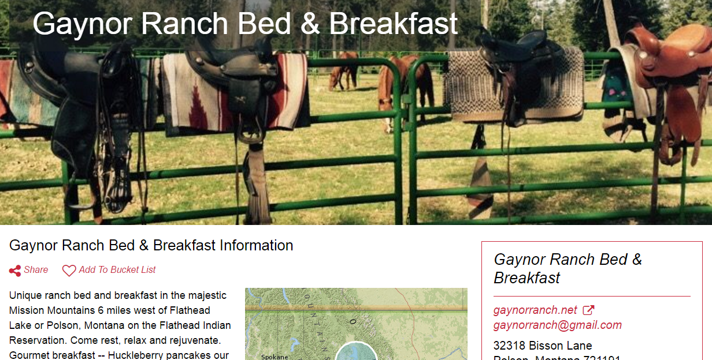
…involving over 100 tribes and native-owned businesses

Slide 10
…across 12 regions.

Slide 11
The site helps educate visitors

Slide 12
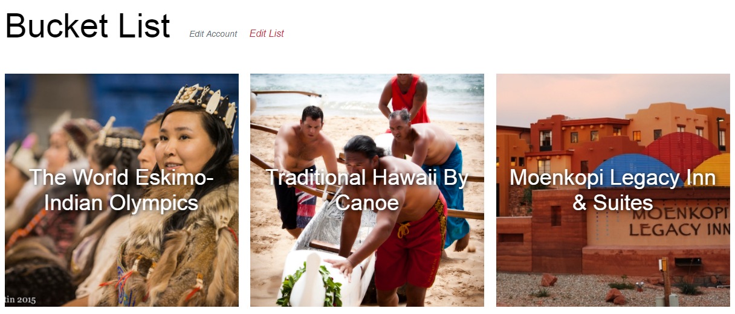
…and inspires them to visit Indian Country.

Slide 13
For our native partners…

Slide 14
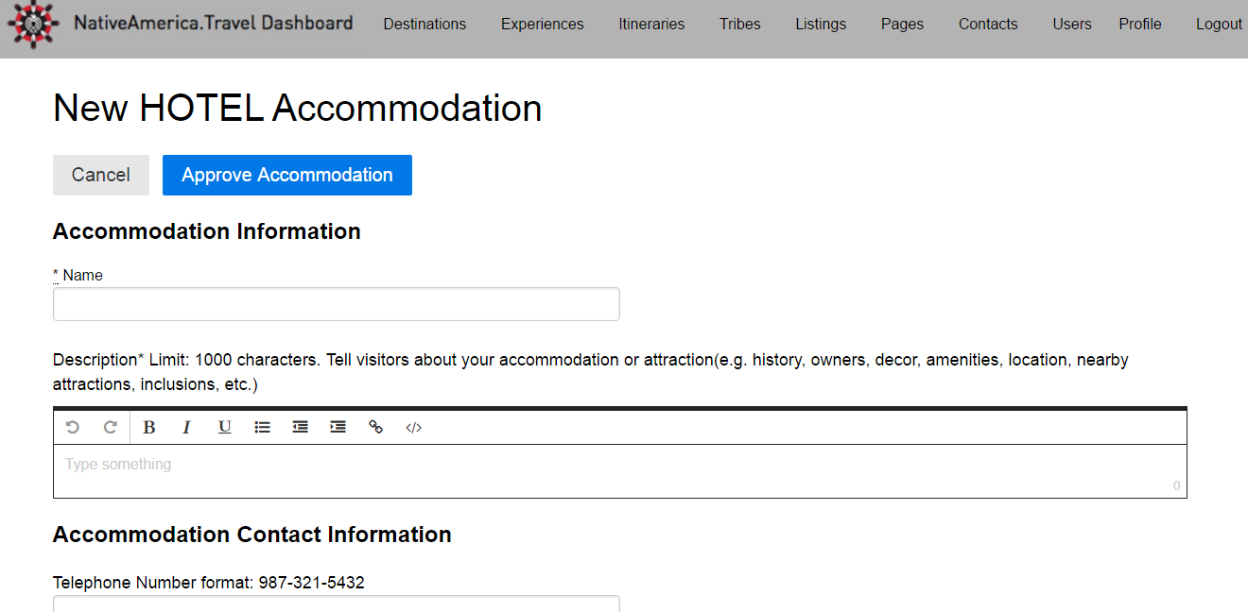
…we built a simple online registration process

Slide 15
…to add accommodations, attractions and itineraries

Slide 16
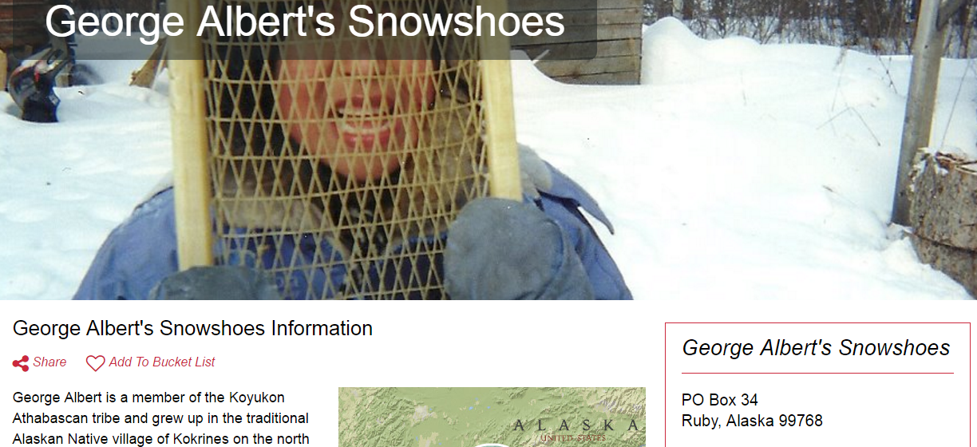
…and give visibility to rural native entrepreneurs.

Slide 17
We have been training native partners throughout the country…

Slide 18
sharing what it takes to become market-ready

Slide 19
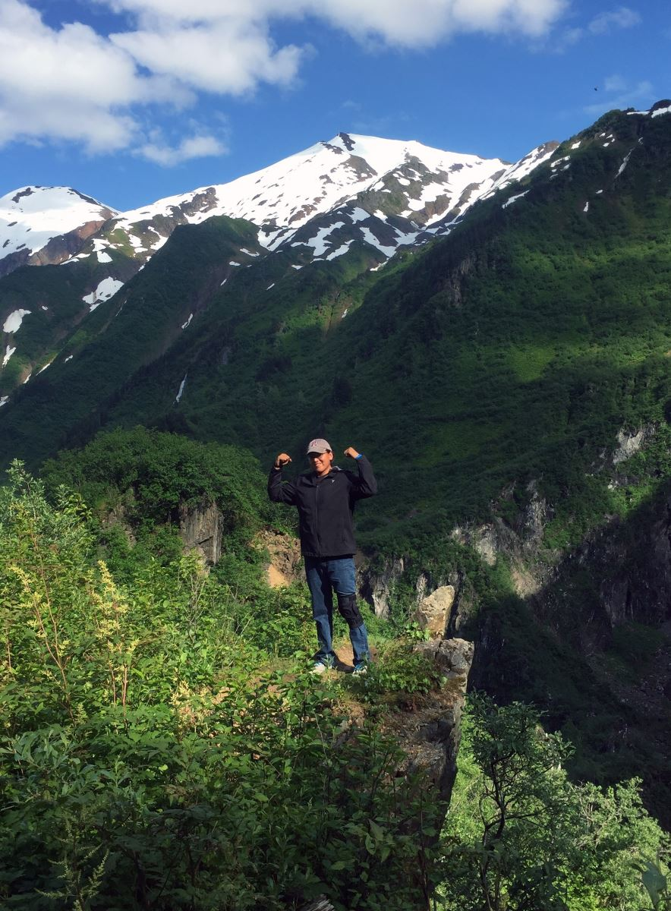
…and engaging youth through the Tourism Development Internship.
“…I learned a tremendous amount of information regarding tourism…One of my favorite training sessions analyzed the market demand in the Flagstaff region. I’m honored to be a summer intern, and I look forward in applying this knowledge into an innovative tribal based economy. Thank you, ahehee’.“
- Burrell Jones, Navajo Nation, 2016 Tourism Development Intern

Slide 20
We are taking NativeAmerica.travel international…

Slide 21
…to build global partnerships

Slide 22
…and market our website partners to tour operators for future growth.

Slide 23
NativeAmerica.travel is gaining momentum
2015
2016

Slide 24
…and is on track to attract over 65,000 unique users next year.

Slide 25
Imagine what we can accomplish next. Join us in looking forward.
With our partners, AIANTA will…

Slide 26
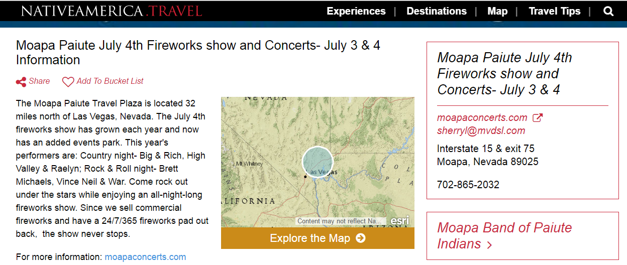
Implement a booking engine & events calendar

Slide 27
Develop an online assessment to determine our tribal partner’s tourism training needs

Slide 28
Design the 1st native tourism statistics package & collection tool
Domestic and international arrivals
Visitor spending
Travel/Transportation
Entertainment
Food & Beverage
Shopping
Accommodation
Room Nights
Employment
Total Economic Impact
Leakages
Direct/Indirect Spending

Slide 29
Create custom GIS tourism assessment training

Slide 30
Join us in making NativeAmerica.travel the leading travel resource for Native America.

Slide 31
Thank you! Questions?
Sandra Anderson sandra.anderson@nativeamerica.travel

